Slide 1
Software Engineering
Module 7
Software Testing –
Concepts, Principles and Techniques
Dr. Shai Koenig
Open University
Department of Computer Science

Slide 2
Topics to be covered
Basic concepts
  what is testing
  dynamic vs. static testing
  testing limitations
  the testing dilemma
  levels of testing
  testing in the development process
  the testing lifecycle
  test environments
  testing and debugging
  functional vs. structural
  who should do the testing
Functional testing techniques
    equivalence partitioning
    boundary value analysis
    state testing
    error guessing
Structural testing techniques
  Module-level
    code coverage
    basis path testing
    data flow testing
    loop testing
  Integration-level
    top-down
    bottom-up
    sandwich
    thread
Non-functional testing
  Load/stress/volume
  Configuration
  Security
  Performance
  Installability
  Reliability
  Recovery
  Serviceability
  Human factors
Test Documentation
  System/Software Test Plan
  Integration Testing Plans
  System/Software Test Specifications
  Test Reports
  Problem Reports and Change Requests

Slide 3
What is testing ?
Testing is the process of exercising a system or system component by manual or automated means to verify that it satisfies specified requirements or to identify differences between expected and actual results [IEEE 83].
Objectives
To detect [and eliminate] as many defects as possible within the resource constraints imposed on the testing activity
to gain confidence in the use of the software
to gather data that will help us assess the effectiveness of our development processes

Slide 4
Terminology
Error,
mistake
Defect,
Fault
Failure,
Incident

Slide 5
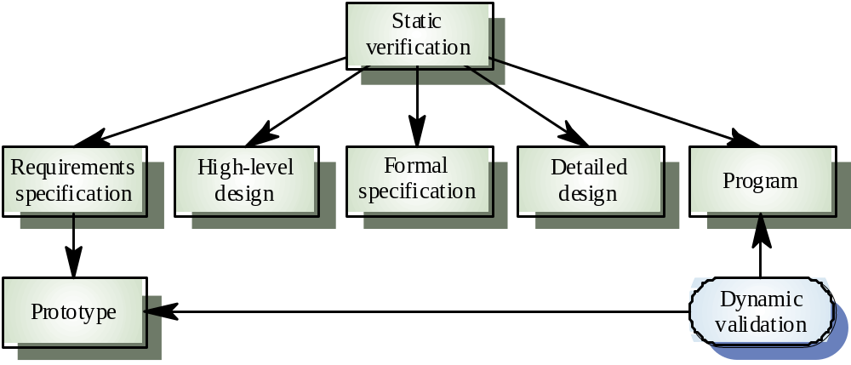
Dynamic and static testing [V&V]
Static testing - Concerned with analysis of static system/ software representations to discover problems
Dynamic testing - Concerned with exercising and observing product behavior to discover problems
In this presentation we will focus on dynamic testing

Slide 6
Testing Limitations
Exhaustive testing is not possible for real systems
Testing cannot show the absence of defects, it can only demonstrate their presence
Testing does not “build in” quality.
If it’s not there before, it won’t be there after !
Testing cannot detect all types of defects.
Testing compares a component’s behavior to its specification - but is the specification correct ?
Is the defect in the software under test or in the test environment?

Slide 7
The testing dilemma
Complete, exhaustive testing is impossible !
30% - 50% of a projects budget may be invested in testing !
The combination of the various forms of testing often finds less than 60% of the defects present.
So, how do we best invest our testing $ [human resources, equipment, schedule, etc.] to optimize our investment, i.e., to find as many, high impact defects as possible?

Slide 8
Levels of Testing
Routine Testing
Module Testing
Software Integration Testing
Software Validation Testing
System Integration Testing
System Validation Testing
Acceptance Testing
    alpha testing
    beta testing

Slide 9
Levels of Testing
Routine Testing
Module Testing
Software Integration Testing
Software Validation Testing
System Integration Testing
System Validation Testing
Acceptance Testing
Unit Testing
Integration Testing
Requirements
Validation Testing

Slide 10
Development Process
System
Requirements
System
Validation
Testing
Software
Requirements
Software
Validation
Testing
Software
Design
Integration
Testing
Software
Construction
Unit
Testing

Slide 11
Testing in the Context of the Development Process
System
Requirements
System
Validation
Test Planning
System
Validation
Testing
Software
Requirements
Software
Validation
Test Planning
Software
Validation
Testing
Software
Design
Integration
Test Planning
Integration
Testing
Software
Construction
Unit Test
Planning
Unit
Testing

Slide 12
The component testing lifecycle
Specify
component
requirements
Design
component
Plan
Testing
Construct
component
Execute Test plan on Component
Evaluate Results
Correct Defects

Slide 13
The component testing lifecycle
Specify
component
requirements
Test Planning
establish test strategy
develop test cases
develop test environment
  stubs, drivers, tools
review test plan
schedule and staff
Design
component
Plan
Testing
Construct
component
Execute Test plan on Component
Evaluate Results
Correct Defects

Slide 14

Component Test Environment
driver
test data
Component
under test
debugger
external
entity
stub
stub

Slide 15
Test data and test cases
Test data - Inputs which have been devised to
test the system
Test cases - Inputs to test the system and the
predicted outputs from these inputs if the
system operates according to its specification

Slide 16
Testing and Debugging
Defect testing and debugging are distinct processes
Defect testing is concerned with confirming the presence of defects
Debugging is concerned with locating and repairing these defects
Debugging involves formulating a hypothesis about program behavior then testing this hypotheses to find the defect
Discover
defect
Locate
defect
Correct
defect
Re-test

Slide 17
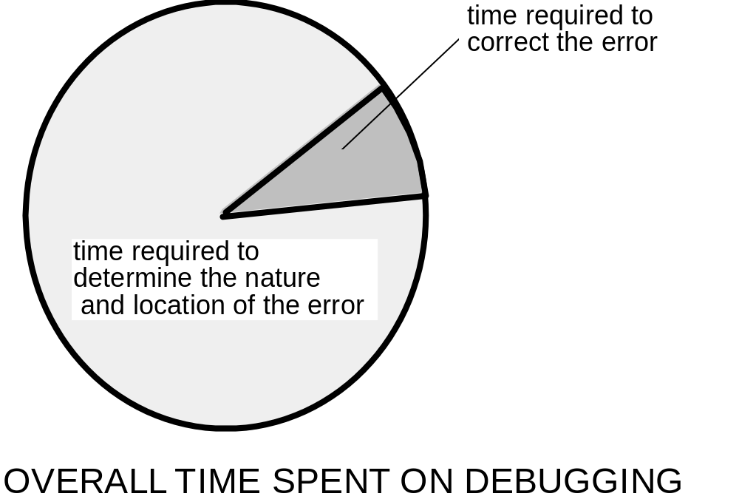
Debugging: A Two Part Process

Slide 18
Regression Testing
Adding features from one release to another can introduce new defects.
Correcting defects as part of a new release or during the testing process can introduce new defects.
Regression testing is the testing of a new version or release to verify that it still performs the same functions in the same manner as its predecessor.
When to do regression testing and how much to include is a difficult decision.

Slide 19
Testing Approaches
Functional [black box] testing
based on the external behavioral requirements of the component
approach to testing where the component is considered as a ‘black-box’
test planning can begin early in the software process
Structural [white box] testing
based on the design and implementation of the component

Slide 20
Functional testing approach
External
entity
External
entity
Component types
routines
modules
subsystem
system
Component
under test
[Black Box]
External
entity
External
entity
External
entity

Slide 21
Structural testing approach
External
entity
External
entity
Component types
routines
modules
subsystem
system
External
entity
External
entity
External
entity

Slide 22
Who should do the testing ?
The developers
understand the software, and
can correct defects, but
are subjective
have as their main goal the delivery of the software on schedule and within budget
face a “conflict of interest”
Independent testers
require an investment to learn the software, and
are more objective, and
have as their main goal the detection of defects, but
do not face a “conflict of interest”, and
cannot, in general, correct defects

Slide 23
Common Testing Approach
Routine
Module
Integration
System
White Box /
Black Box
Grey Box
Black Box
Development
Team
Independent
Test Team

Slide 24
Topics to be covered
Basic concepts
  what is testing
  dynamic vs. static testing
  testing limitations
  the testing dilemma
  levels of testing
  testing in the development process
  the testing lifecycle
  test environments
  testing and debugging
  functional vs. structural
  test data and test cases
  who should do the testing
Functional testing techniques
    equivalence partitioning
    boundary value analysis
    state testing
    error guessing
Structural testing techniques
  Module-level
    code coverage
    basis path testing
    data flow testing
    loop testing
  Integration-level
    top-down
    bottom-up
    sandwich
    thread
Non-functional testing
  Load/stress/volume
  Configuration
  Security
  Performance
  Installability
  Reliability
  Recovery
  Serviceability
  Human factors
Test Documentation
  System/Software Test Plan
  Integration Testing Plans
  System/Software Test Specifications
  Test Reports
  Problem Reports and Change Requests

Slide 25
Functional testing approach
External
entity
External
entity
Component types
routines
modules
subsystem
system
Component
under test
[Black Box]
External
entity
External
entity
External
entity

Slide 26
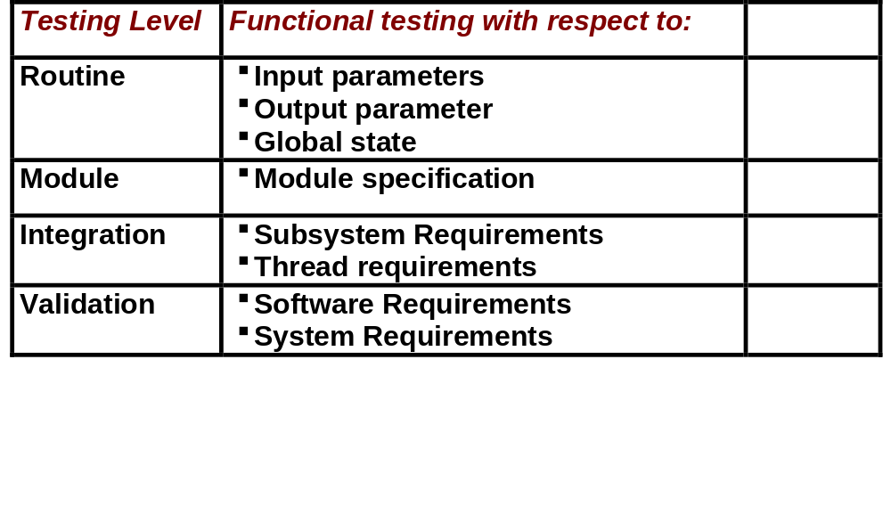
Functional Testing

Slide 27
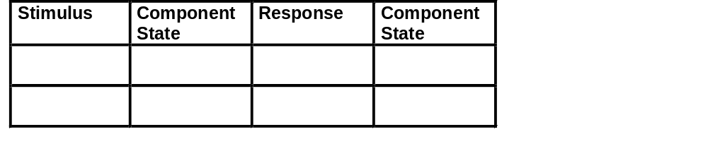
Functional Test Planning
The requirements of a component may be viewed as a function
State x Response
Stimulus x State
These requirements must be translated into test cases

Slide 28
Functional Testing Techniques
How do we select test inputs that are likely to reveal defects ?
Experience and Domain Knowledge
Equivalence Partitioning
Boundary Value Analysis
Cause Effect Graphing
State Testing
Error Guessing

Slide 29
Equivalence Partitioning
An input domain is partitioned into classes of values based on the functional behavior of the component.
Classes are selected so that the component behaves identically for all input values in a single class.
These classes are called equivalence classes.
Each equivalence class yields a test case, by selecting a representative value from the class.
Often actual input domains are cartesian products of individual input domains. In these cases, the actual input domain is the cartesian product of the individual input domains.
Equivalence partitioning may also be applied to output domains.

Slide 30
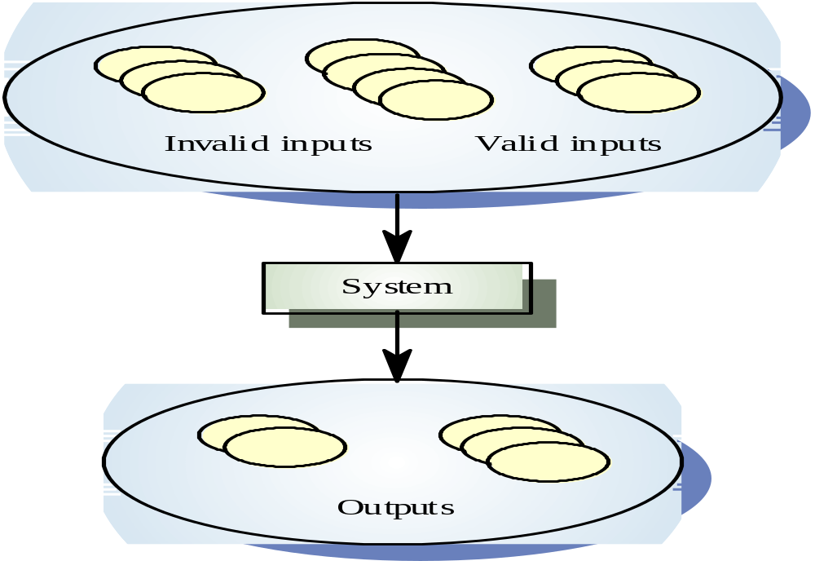
Equivalence partitioning

Slide 31
Equivalence partitioning
Partition system inputs and outputs into
‘equivalence classes’
  If input is a 5-digit integer between 10,000 and 99,999,
  equivalence partitions are
    <10000
    10000-99999 and
    >= 100000
Choose representative test cases within each of the equivalence classes

Slide 32
Boundary Value Analysis
Errors are often made at the boundaries of equivalence classes.
Select input values at the boundaries of the input domain equivalence classes
  just within the boundaries
  just outside the boundaries

Slide 33
Boundary Value Analysis
Partition system inputs and outputs into
‘equivalence classes’
  If input is a 5-digit integer between 10,000 and 99,999,
  equivalence partitions are
    <10000
    10000-99999 and
    >= 100000
Choose test cases at the boundary of these classes
  00000, 09999, 10000, 99999, 100000

Slide 34
State Testing
Used for testing components whose behavioral requirements are state driven.
Plan to test
  state transition functions
  output functions
Each state/input combination should be tested.
State-based test planning already returns large payoffs during test planning.
Note: instrumentation is needed to detect the state transitions.
State transition tables are a useful tool for state testing.

Slide 35
Error Guessing
Creating test cases based on guesses about where the program is more likely to have defects.
Based on
  intuition
  knowledge of requirements
  knowledge of design
  personal experience
  collective experience [which may be codified in checklists]

Slide 36
Topics to be covered
Basic concepts
  what is testing
  dynamic vs. static testing
  testing limitations
  the testing dilemma
  levels of testing
  testing in the development process
  the testing lifecycle
  test environments
  testing and debugging
  functional vs. structural
  test data and test cases
  who should do the testing
Functional testing techniques
    equivalence partitioning
    boundary value analysis
    state testing
    error guessing
Structural testing techniques
  Module-level
    code coverage
    basis path testing
    data flow testing
    loop testing
  Integration-level
    top-down
    bottom-up
    sandwich
    thread
Non-functional testing
  Load/stress/volume
  Configuration
  Security
  Performance
  Installability
  Reliability
  Recovery
  Serviceability
  Human factors
Test Documentation
  System/Software Test Plan
  Integration Testing Plans
  System/Software Test Specifications
  Test Reports
  Problem Reports and Change Requests

Slide 37
Structural testing approach
External
entity
External
entity
Component types
routines
modules
subsystem
system
External
entity
External
entity
External
entity

Slide 38
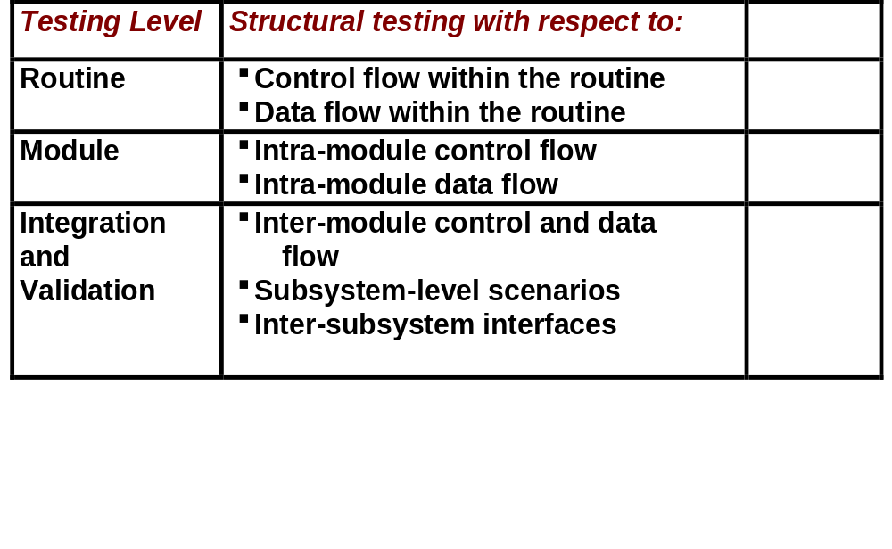
Structural Testing

Slide 39
Structural Testing at the Routine-level
Coverage
  Statement coverage
  branch coverage
  decision coverage
Basis path testing
Data flow analysis testing
Loop testing

Slide 40
Structural Testing at the Routine-level
Code Coverage
To measure the level of thoroughness achieved during testing we can measure the coverage of tested code
  statement coverage - the percent of statements actually executed during testing
  branch coverage - the percent of branches actually followed during test execution
  decision coverage - the percent of atomic conditions actually followed during test execution
A coverage monitor is a tool that keeps track of the code that is exercised and the code that isn’t.
Coverage monitors
  provide an indication of whether a set of test cases fully exercises the code.
  identifies the actual statements, branches and conditions that have not been exercised.

Slide 41
Structural Testing at the Routine-level
But how do we achieve maximum coverage at minimum cost ?

Slide 42
Structural Testing at the Routine Level
Basis Path Testing
An approach that produces a minimum number of test cases that tests all independent paths through the code
If all of these paths are executed, then
  every statement in the routine has been executed at least once.
  every branch has been exercised for true and false conditions
Complete basis path testing implies 100% branch coverage [which, of course, implies 100% statement coverage].

Slide 43
Structural Testing at the Routine-level
Basis Path Testing
Calculate the program’s control flow graph
    A flow graph consists of nodes representing decisions and edges representing flow of control.
Calculate the graph’s Cyclomatic complexity
    Cyclomatic Complexity = Number of edges - Number of nodes + 2
    For programs without goto statements, the cyclomatic complexity is equal to the number of conditions in the code plus one.
    The minimum number of test cases required to test all independent paths is equal to the cyclomatic complexity.
    Note: Cyclomatic complexity is also used as a code quality metric
Determine the independent program paths [those that traverse at least one new edge in the flow graph, I.e., exercises one or more new conditions]
Design test cases to exercise each of these paths.
There are automated tools to support this process.

Slide 44
Integration-level Structural Testing Techniques
Theoretically testing a large component could proceed as follows:
1. Test each sub-component separately and completely
2. Assemble the component from its sub-components
3. Test the component
This strategy suffers from a number of problems:
1. It requires a large investment in sub-component scaffolding [stubs and drivers].
2. The component is too large [big bang integration]
3. It does not focus on interfaces between sub-components

Slide 45
Incremental Integration Testing
Test of compound component by incrementally adding sub-components or functionality
Tested sub-components serve as stubs and drivers for other sub-components to be tested.
Each increment focuses on newly executed sub-components, interfaces and/or features
Sub-components are tested more thoroughly

Slide 46
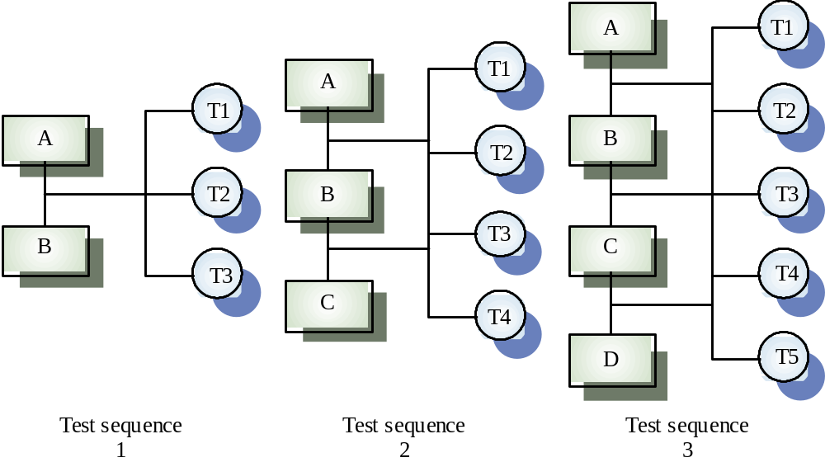
Incremental testing
Modules: A, B, C, D
Test Cases: T1, T2, T3, T4, T5

Slide 47
Integration-level Structural Testing Techniques
Top-down integration technique
Bottom-up integration technique
Sandwich integration technique
Thread integration technique
In the context of integration and testing, bottom-up and
top-down refer to the control or uses topology of the components.
Note that testing is always bottom-up [in the design sense], starting at the lowest component levels [routines] and ending with the highest component levels [system].

Slide 48
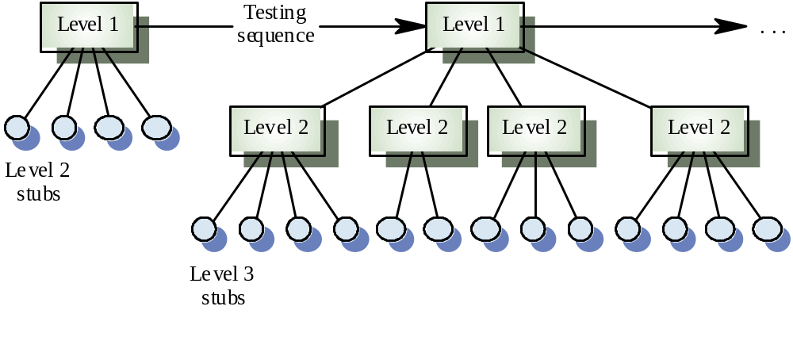
Top-down testing

Slide 49
Top-down testing
Start with the high-levels of a system and work your way downwards [relative to the “uses” or control topology]
Finds architectural errors
May need system infrastructure before any testing is possible
May be difficult to develop program stubs
Particularly relevant for systems whose control is hierarchical

Slide 50
Bottom-Up Incremental Integration Testing
driver
driver

Slide 51
Bottom-Up Incremental Integration Testing
driver

Slide 52
Bottom-Up Incremental Integration Testing

Slide 53
Bottom-up testing
Necessary for critical infrastructure components
Start with the lower levels [in the control or “uses” sense] of the system and work upward
Needs test drivers to be implemented
Does not find major design problems until late in the process
Appropriate for object-oriented systems
Particularly suitable for reuse

Slide 54
Sandwich Incremental Strategy
Top-down the “higher level” components
Bottom-up the “lower-level” components
permits more parallelism

Slide 55
Sandwich Incremental Integration Testing
stub
stub
driver
driver

Slide 56
Sandwich Incremental Integration Testing

Slide 57
Thread testing
Suitable for real-time and object-oriented systems
Based on testing an operation which involves a sequence of processing steps which thread their way through the system
Start with single event threads then go on to multiple event threads
Complete thread testing is impossible because of the large number of event combinations
Threads are related to design level scenarios [e.g., sequence diagrams, collaboration diagrams]
Top-down and bottom-up are component based strategies, threads are function based.

Slide 58
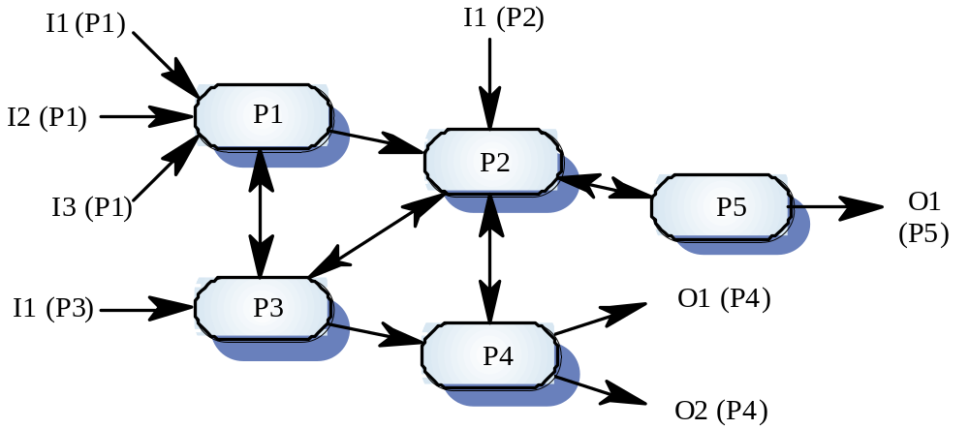
Process interactions

Slide 59
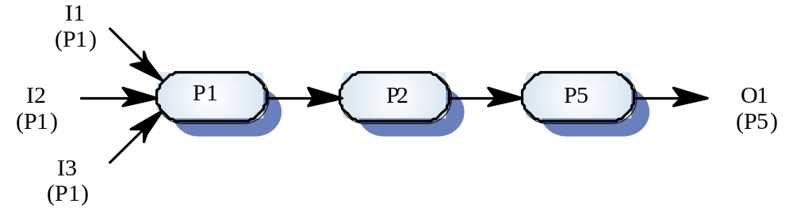
Thread testing

Slide 60
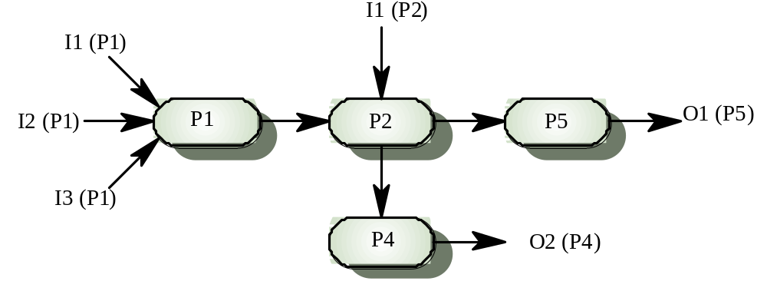
Multiple-thread testing

Slide 61
Topics to be covered
Basic concepts
  what is testing
  dynamic vs. static testing
  testing limitations
  the testing dilemma
  levels of testing
  testing in the development process
  the testing lifecycle
  test environments
  testing and debugging
  functional vs. structural
  test data and test cases
  who should do the testing
Functional testing techniques
    equivalence partitioning
    boundary value analysis
    state testing
    error guessing
Structural testing techniques
  Module-level
    code coverage
    basis path testing
    data flow testing
    loop testing
  Integration-level
    top-down
    bottom-up
    sandwich
    thread
Non-functional testing
  Load/stress/volume
  Configuration
  Security
  Performance
  Installability
  Reliability
  Recovery
  Serviceability
  Human factors
Test Documentation
  System/Software Test Plan
  Integration Testing Plans
  System/Software Test Specifications
  Test Reports
  Problem Reports and Change Requests

Slide 62
Performance [Non-functional] Testing
Load/stress/volume
Configuration
Security
Timing
Environmental
Installability
Reliability
Recovery
Maintainability
Human factors
For a particular system, some types of performance testing may be irrelevant.

Slide 63
Load/Stress Testing
Objective:
  To identify the peak load conditions at which the system fails.
Conditions:
  The system is subjected to peak rates for the key operational parameters, including transaction volume, operator/used load, file activity, error rates, and key combinations
Considerations:
  Such tests are rarely run because they require large configurations, need extensive preparation and support, and the stress conditions are considered unlikely.
  It is, however, precisely these unlikely conditions that are the most dangerous.

Slide 64
Load/Stress testing
Exercises the system beyond its maximum design load. Stressing the system often causes defects to
come to light
Stressing the system test failure behavior. Systems should not fail catastrophically. Stress testing checks for unacceptable loss of service or data
Particularly relevant to distributed systems
which can exhibit severe degradation as a
network becomes overloaded

Slide 65
Configuration Testing
Objective:
  To identify those legal hardware and/or software configurations on which the system will not operate correctly.
Conditions:
  All legal hardware and software configurations should be tested at the minimum and maximum configuration limits.
Considerations:
  Subject to high installation costs.
  Lack of configuration availability.
  Cartesian product of virtual machine components

Slide 66
Security Testing
Objective:
  To find ways to break the security provisions of the system
Conditions:
  In addition to communications and software loopholes, include testing of physical plant security procedures.
  As a result of the spread of the internet, this has become a primary issue.
Considerations:
  an evolving specialty - expert advice is generally advisable

Slide 67
Timing Testing
Objective:
  To determine that the system meets time-related requirements, such as reaction time and throughput, under peak and normal conditions.
Conditions:
  Typical transaction rates and/or response times are measured.
Considerations:
  Timing objectives are not always specified.
  Predecessor systems can be used as a baseline for comparison.
  Such testing may incorporated into the functional testing [as is the case in requirements specification].

Slide 68
Environmental Testing
Objective:
  To determine the systems [in]ability to perform at the installation site.
Conditions:
  This typically includes testing tolerances for extreme levels of temperature, humidity, motion, electrical or magnetic fields, disruption of power, etc.
Considerations:
  This is usually a systems engineering issue.

Slide 69
Installability Testing
Objective:
  To identify the problems resulting from system installation procedures.
Conditions:
  The need is to test the installation procedures in accordance with the system’s installation instructions.
Considerations:
  Generally the developers know too much about the system to produce understandable and robust installation instructions.
  Therefore installability testing should be performed by typical users, who do not share the developers knowledge.

Slide 70
Reliability Testing
Objective:
  To assess the reliability of the system while the system is operating with a typical load.
Conditions:
  This generally involves operating the system for long periods and measuring its reliability.
Considerations:
  Often estimated by measuring mean time to failure during the other system tests.
  When time and facilities are available, this is done using long-term burn-in tests with simulated or actual application loads.
  Infeasible to administer when long mean times have been mandated.

Slide 71
Recovery Testing
Objective:
  To determine the behavior of the system after the occurrence of a serious error or other abnormal condition.
Conditions:
  This test is often best conducted during the other system tests or with special burn-in tests.
Considerations:
  Often forgotten.
  If not tested in the course of other forms of testing, then special tests should be run with artificially induced errors and abnormal conditions.

Slide 72
Maintainability Testing
Objective:
  To identify erroneous conditions in which the system does not provide the required information and facilities needed by service personnel.
Conditions:
  This type of test involves inducing typical system errors and assessing the information and facilities provided by the system to facilitate fault location and correction [software, hardware and procedures] .
Considerations:
  This issue is often omitted in requirements.
  One of the most difficult types of testing.

Slide 73
Human Factors [Usability] Testing
Objective:
  To identify those operations that will be difficult, inconvenient or prone to error for the users or operators.
Conditions:
  This type of testing should include testing the user interface itself as well as user manuals, on-line help facilities, on-line documentation, etc.
Considerations:
  This type of testing should be done by actual end-users, using the delivered manuals, and be conducted in the context of real operating conditions or conditions that closely approximate the real operating environment.

Slide 74
Usability Testing process
Select typical users of the system as “evaluators”
Define the tasks that the evaluators will try to perform
Observe and record the problems encountered by the evaluators
Analyze the root cause of the problems
Suggest design changes that will eliminate the root causes.
There are usability testing specialists and labs using video cameras, one-way mirrors and other types of recording equipment.

Slide 75
Testing effectiveness
Reviews [in their various forms] have been shown to find a higher percentage of defects than testing, while costing only half as much per defect found [Card, McGarry and Page, “Evaluating Software Engineering Technologies,” IEEE Transactions on Software Engineering, February, 1987]
Static code reviewing was less expensive and more effective in discovering program faults
In an experiment, black-box testing was found to be more effective than structural testing in discovering defects

Slide 76
Topics to be covered
Basic concepts
  what is testing
  dynamic vs. static testing
  testing limitations
  the testing dilemma
  levels of testing
  testing in the development process
  the testing lifecycle
  test environments
  testing and debugging
  functional vs. structural
  test data and test cases
  who should do the testing
Functional testing techniques
    equivalence partitioning
    boundary value analysis
    state testing
    error guessing
Structural testing techniques
  Module-level
    code coverage
    basis path testing
    data flow testing
    loop testing
  Integration-level
    top-down
    bottom-up
    sandwich
    thread
Non-functional testing
  Load/stress/volume
  Configuration
  Security
  Performance
  Installability
  Reliability
  Recovery
  Serviceability
  Human factors
Test Documentation
  System/Software Test Plan
  Integration Testing Plans
  System/Software Test Specifications
  Test Reports
  Problem Reports and Change Requests

Slide 77
Test Documentation
System/Software Test Plan
Integration Testing Plans
System/Software Test Specifications
Test Reports
Problem Reports and Change Requests

Slide 78
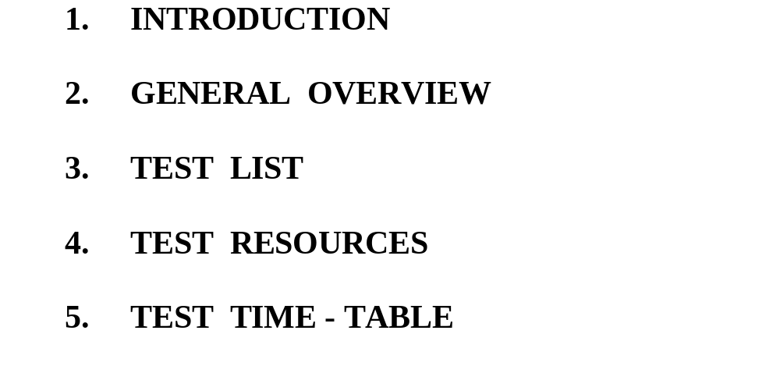
System/Software Test Plan

Slide 79
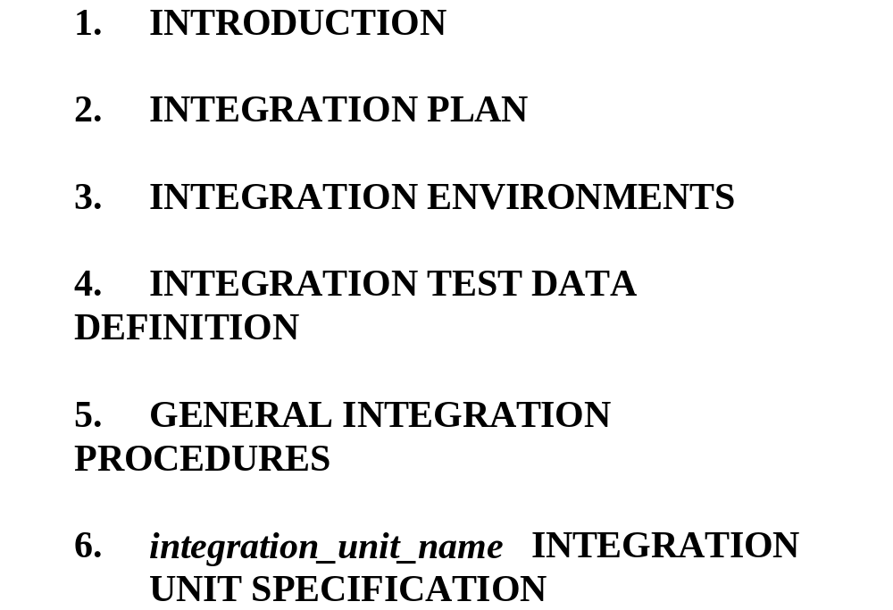
Unit Integration Plan

Slide 80
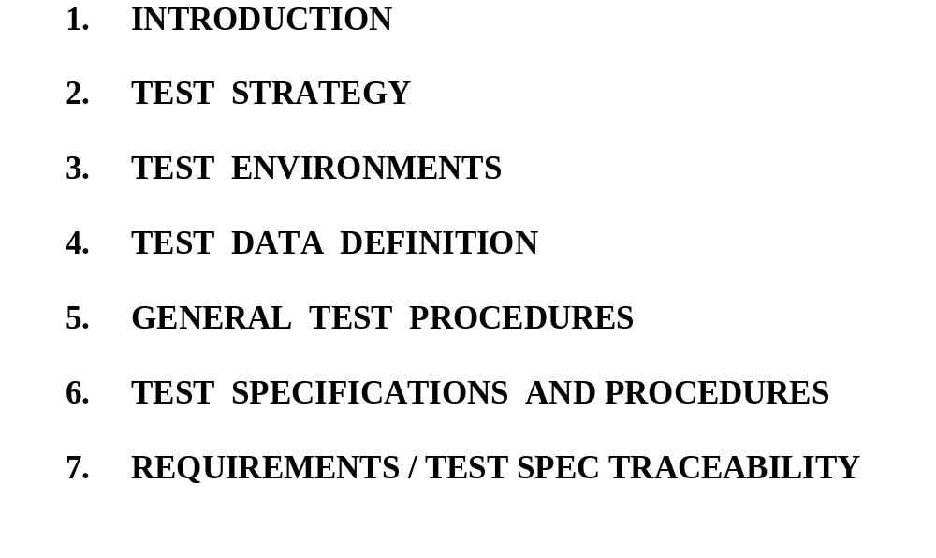
System/Software Test Specification

Slide 81
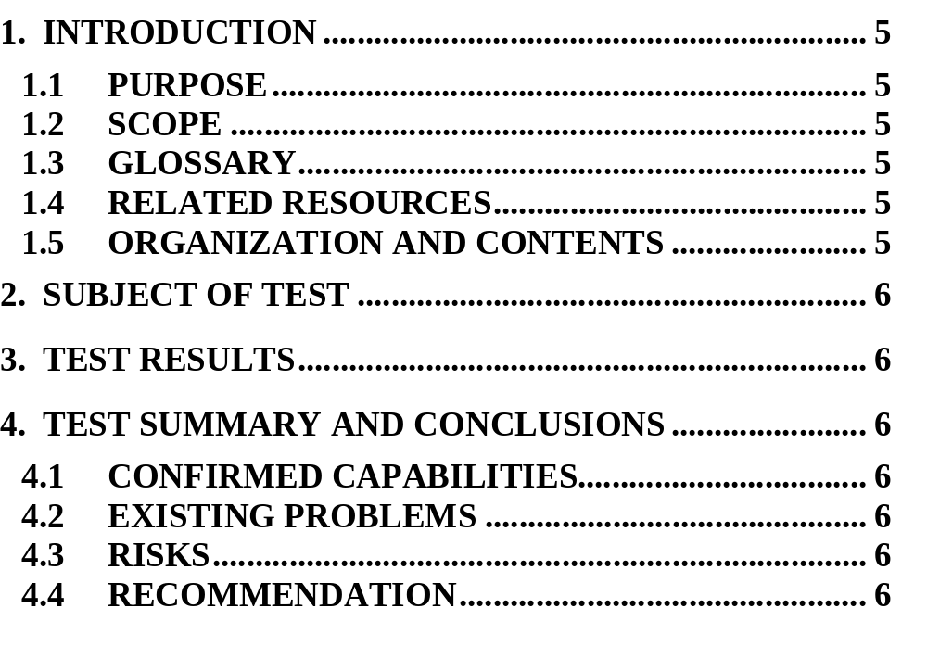
Unit Test Report

Slide 82


